Slide 1
Key benefits of Crossrail 2
Crossrail 2 would:
Add around 10 per cent to London’s transport capacity
Significantly improve journey time for a wide range of journeys
Provide a step change in accessibility levels and access to jobs in Opportunity Areas – Angel Road, Northumberland Park stations
This would:
Unlock 200,000 new homes
Support 200,000 new jobs
Support 60,000+ construction sector and supply chain jobs across the UK
Create opportunities for apprenticeships, training and local employment (Crossrail has created 400+ apprenticeships and thousands of jobs for local people)
Notes:
Currently Angel Road has long gaps in services, and just one train an hour into London during the morning peak period.

Slide 2
Identifying development opportunities around Crossrail 2 stations
To Waterloo
Key
Crossrail 2 route
National rail
Tramlink
District line
Bus corridors
Crossrail 2 station
Connecting rail station
Connecting District line station
Connecting Tramlink stop
District line
1km
Impact Area – 1km from Crossrail 2 stations
Bus corridors
Tramlink
CR2 Connecting stations
Wider Area Assessment [including property market areas; bus corridors; wider area intensification]
To Sutton
Notes:
The development impacts around Crossrail 2 stations are not limited to the station. The benefits of Crossrail 2 in helping to realise development benefits will cover up to 1km from the station as well as wider property market areas and major growth areas which are linked by connecting stations and supporting transport corridors.

Slide 3
Identifying opportunities for housing growth
  Approach looks at what can be achieved over and above a no Crossrail 2 scenario (do-min vs CR2)
Transport benefits
(capacity, frequency, journey times)
Site Identification (c.3,000)
(intensify existing, develop new)
Apply density assumptions / development opportunities
Potential housing and employment uplift supported by Crossrail 2

Slide 4
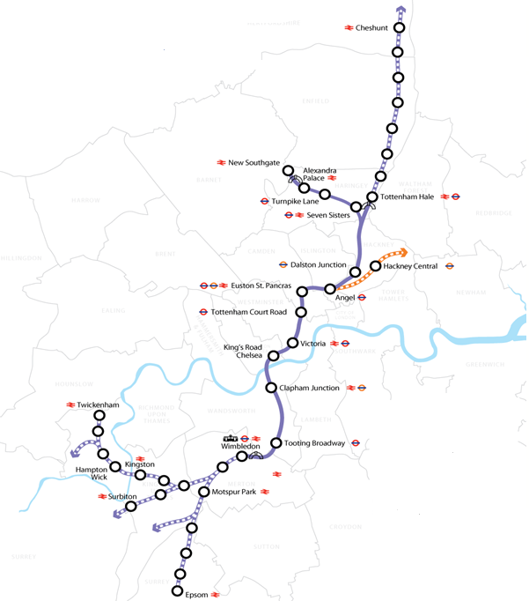
Overview of additional homes unlocked by Crossrail 2
NE Non-London
15,000 - 45,000
Including connecting areas further afield
Housing ranges demonstrates additional homes which could be unlocked by CR2 under Current Practice and New CR2 Policy up to 2060 (above do-minimum ~90,000 homes)
Even without change in existing planning policies the step change in Transport benefits alone releases 80,000 homes (on top of do-min)
CR2 led strategy could deliver 200,000 additional homes (on top of do-min)
Assumptions being tested through CR2 Growth Commission and LPA engagement – potential for even higher growth
numbers to be realised if more
ambitious CR2 led planning policy is
taken forward.
NE Outer London
20,000 - 50,000
NE Inner London
10,000 - 15,000
CAZ
5,000 - 10,000
SW Inner London
10,000 – 20,000
SW Outer London
10,000 – 30,000
SW Non-London
10,000 – 30,000
Including connecting areas further afield
Notes:
Crossrail 2 could unlock the delivery of around 200,000 new homes in the Crossrail 2 corridor and wider South East, over and above the c90,000 that we estimate are likely to come forward anyway.
This work is the outcome of a significant bottom-up site specific analysis exercise, looking at more than 3,000 sites.
The London Plan identifies opportunity areas. Areas with the potential for both regeneration and growth. And the largest opportunity area is in the northeast – the Upper Lea Valley. Here, levels of deprivation are very high.

Slide 5
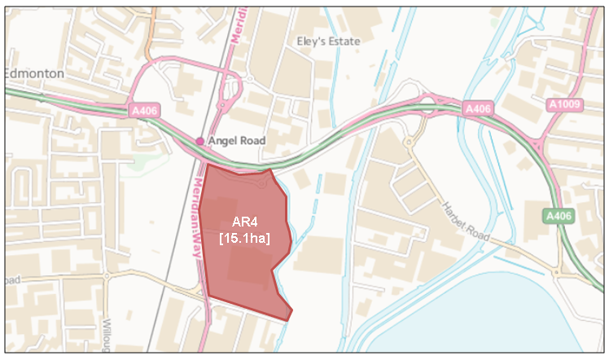
Crossrail 2 supporting uplift within existing regeneration areas
Step 1: Identify site with development potential
Meridian Way, Angel Road
Site area: 15.1 hectares
Step 3: Examine potential planning policy scenarios including:
land use mix (residential / employment)
employment density
housing density
 |  | Net additional homes and jobs
 | Do Minimum | With Crossrail 2
Homes | 600 | Up to 2,100
Jobs (on - site and residential led) | 500 | Up to 800
Step 4: Calculate net additional growth
Step 2: Calculate transport improvements
 | No Cr2 | With Cr2
PTAL levels in the 1km surrounding the station | 1-2 | 3-4
Approx. capacity on rail services to C. London / hr | 2,000 | 17,500
Trains per hour, per direction, peak time | 3 | 12
Jobs within 45 minutes | 650,000 | 2,000,000
Notes:
Do minimum already takes account of STAR and the planned regeneration proposals as set out in the Meridian Water Masterplan
Additional transport connectivity and accessibility as a result of Crossrail 2 can further support established regeneration objectives.

Slide 6
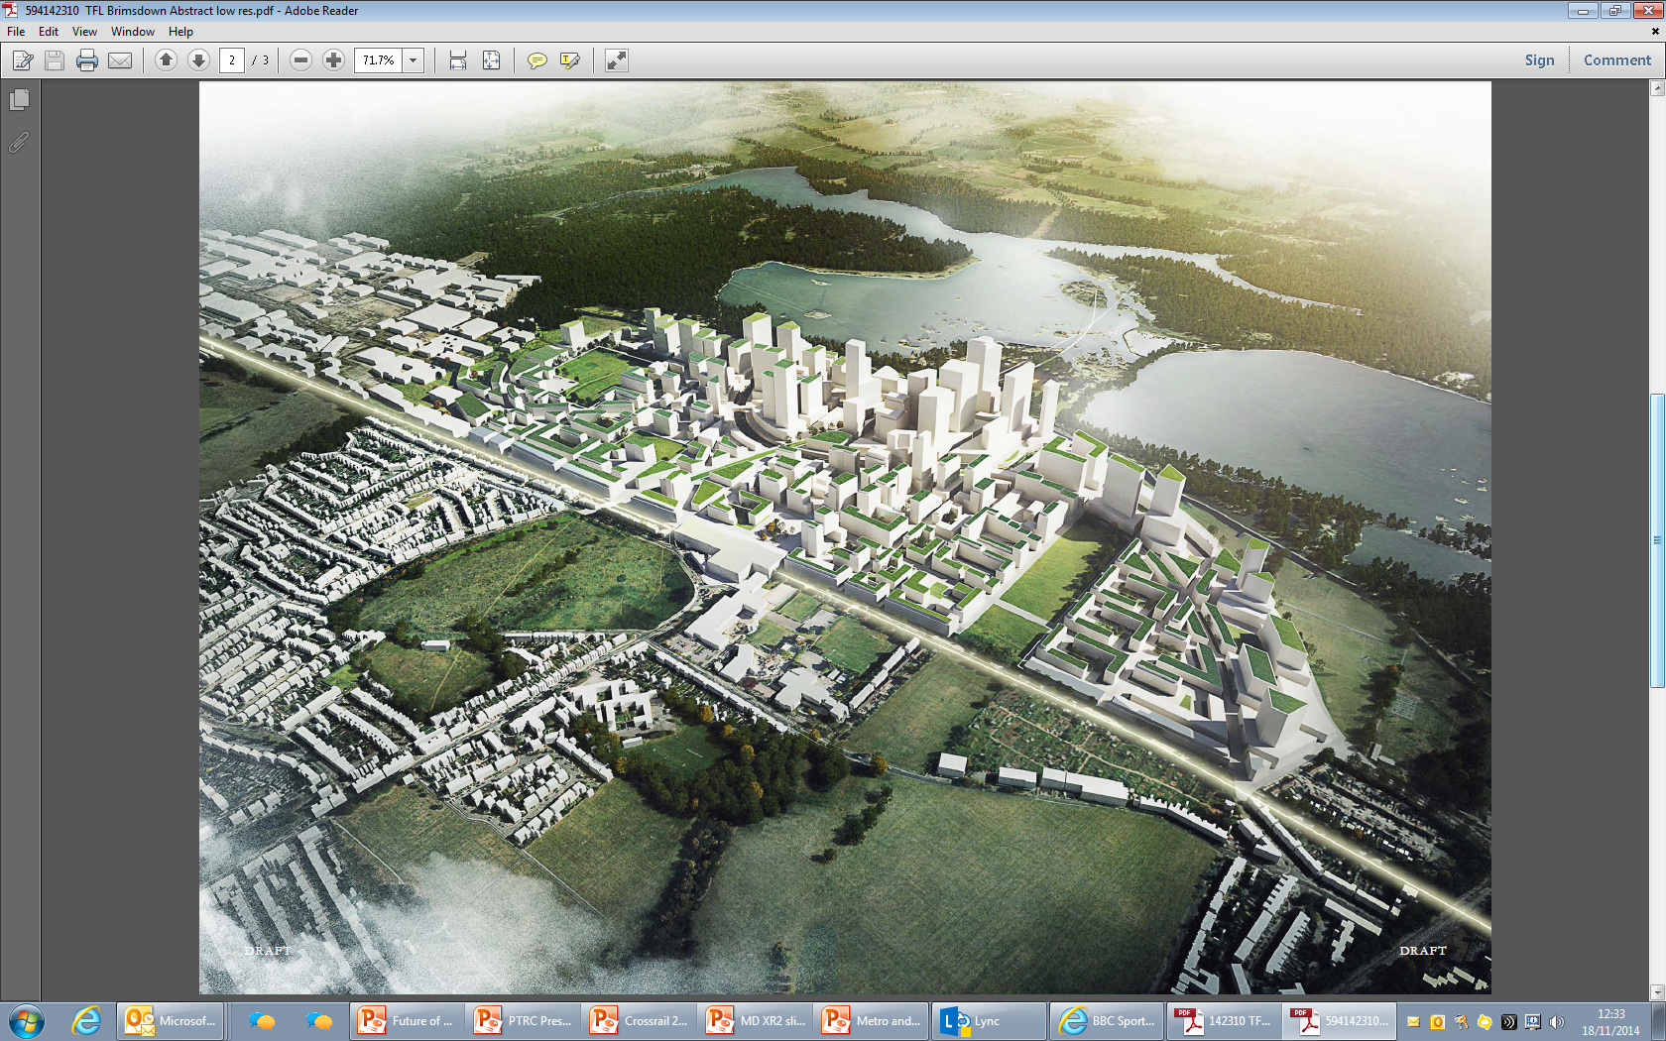
Housing development provides an opportunity for local regeneration
Public transport improvements will make sites more attractive to developers. Analysis shows this will lead to high levels of house building and job creation which will create new economic opportunities and bring unused areas back into life
This could have a ripple affect, sparking area wide regeneration opportunities. E.g.
  Hackney Wick
  Woolwich
Needs to be supported by integrated local development plans led by GLA / London Boroughs

Slide 7
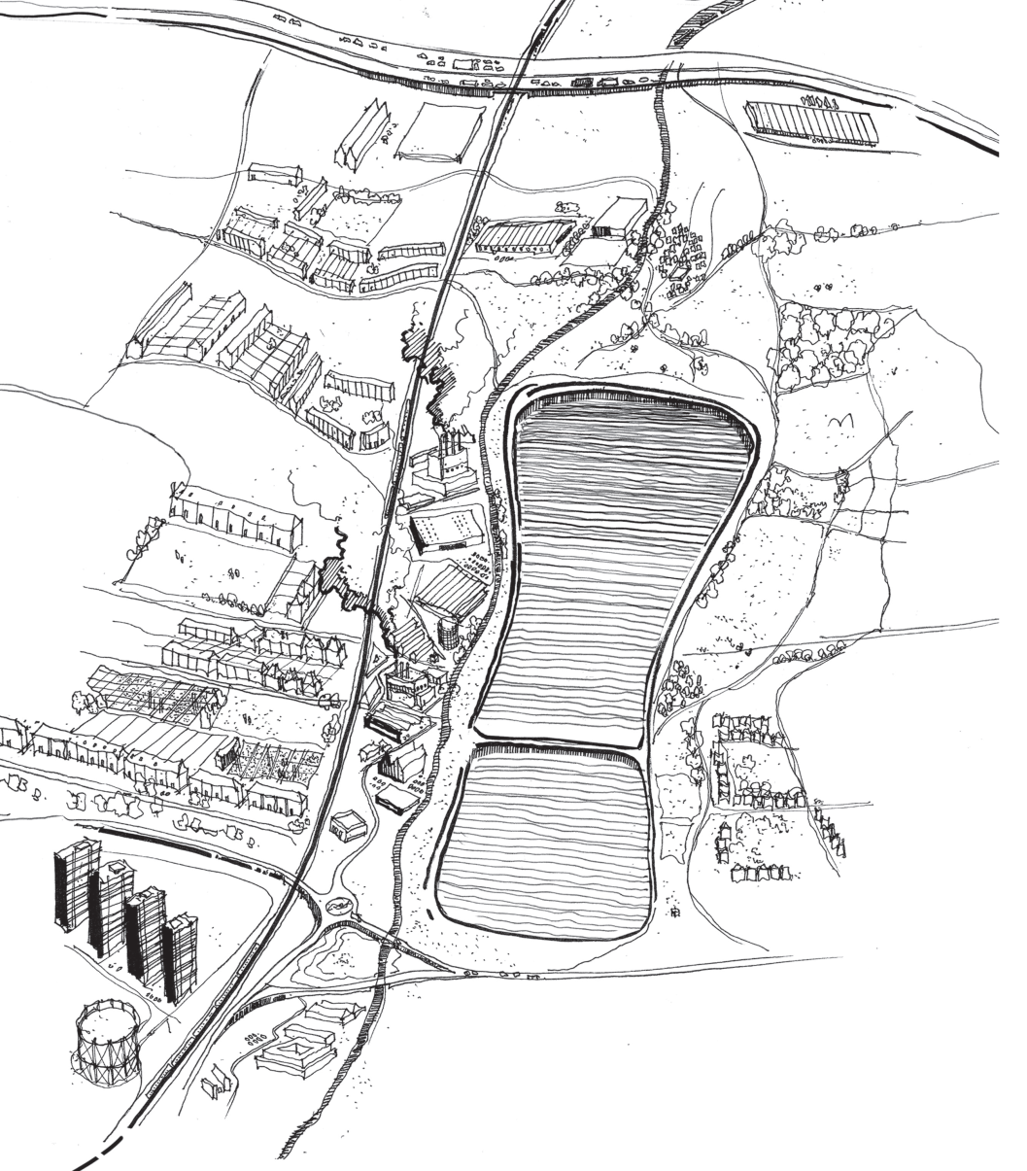
How will we maximise regeneration opportunities?
Working with Local Authorities to identify opportunities for developing comprehensive local masterplans and development strategies
These would demonstrate Crossrail 2’s potential to regenerate areas and create new opportunities for local communities
This builds on housing potential opportunities, demonstrating the place making potential of Crossrail 2
Also an opportunity to think about local employment and training opportunities
Notes:
Current discussions with RB Kingston in relation to Tolworth; LB Enfield in relation to Upper Lea Valley.

Slide 8
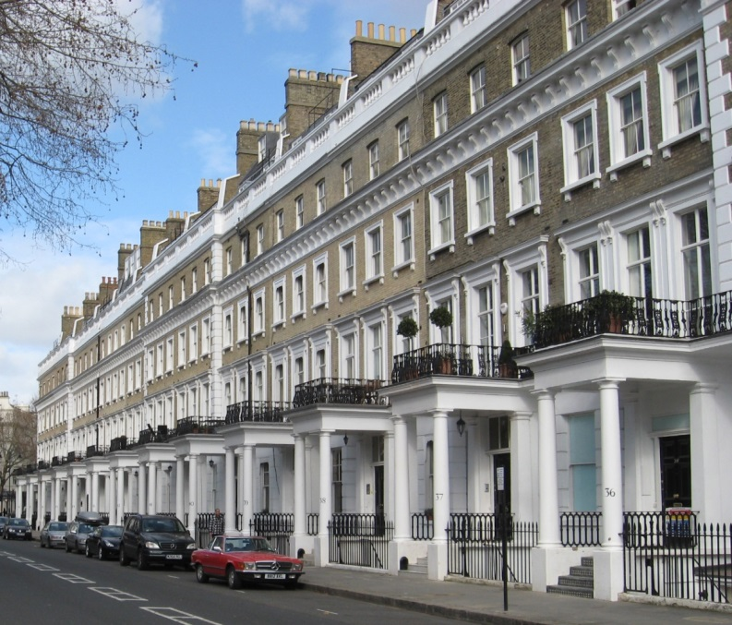
How will we maximise regeneration opportunities?
Through the Crossrail 2 independent Growth Commission
  Remit to help ensure that opportunities for regeneration, house building and job creation made possible by the new railway can be developed to their full potential
  Working with London boroughs, county and district councils outside London and other key stakeholders
  The Growth Commission will report in spring 2016, allowing the Crossrail 2 team to ensure plans for local development and the route are aligned
  High density housing: Kensington & Chelsea

Slide 9
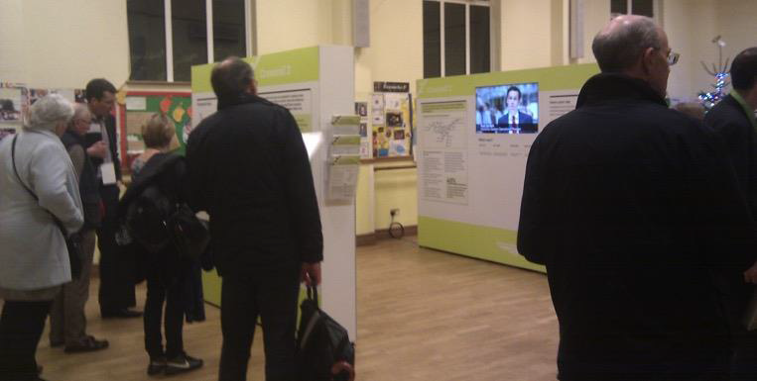
How will we maximise regeneration opportunities?
Consultations and public engagement to understand community needs and aspirations early in the scheme development
  Public consultation to present early thinking on station layouts
  Established community liaison panels
  Ongoing dialogue with community throughout scheme development

Slide 10
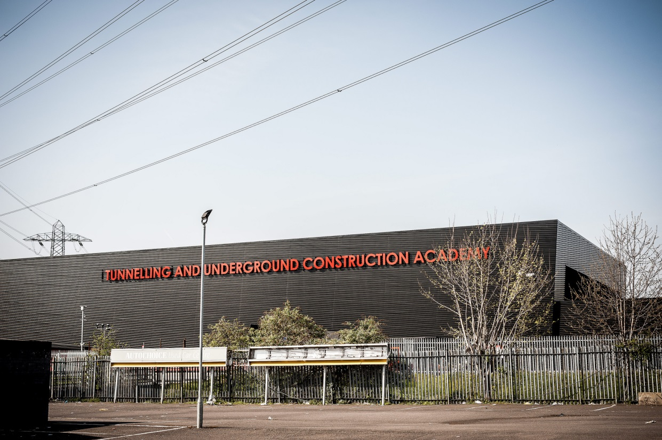
How will we maximise regeneration opportunities?
Working with local employers and the supply chain to maximise opportunities
Building on Crossrail we will support apprenticeships, training programmes and will create new job opportunities
Creating opportunities for local people – eg. through continuing the work of the TUCA academy in Ilford

Slide 11
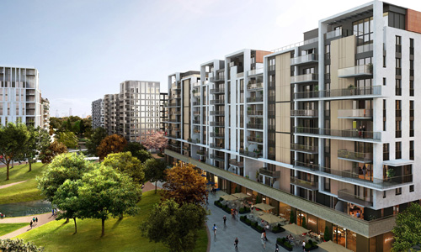
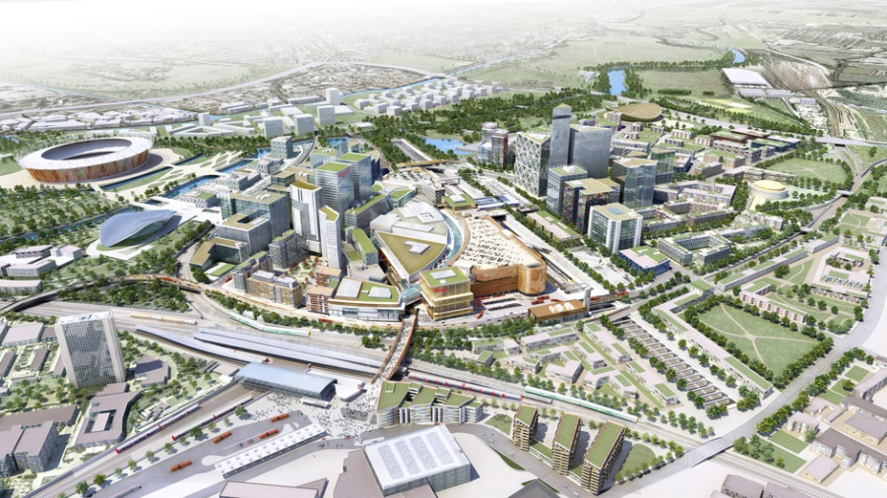
Conclusion
Crossrail 2 is not just a transport project. By supporting house building and improving access to jobs in some of London’s largest Opportunity Areas, it could regenerate large areas of London.
Potential to build 200,000 new homes and create 200,000 jobs in local communities.
Early engagement of local authorities and communities is vital to maximise the benefits
Stratford Athletes’ village
Stratford masterplan

